Slide 1
Controlling LED chains with FPGA
Author : Daniil Ignatev

Slide 2
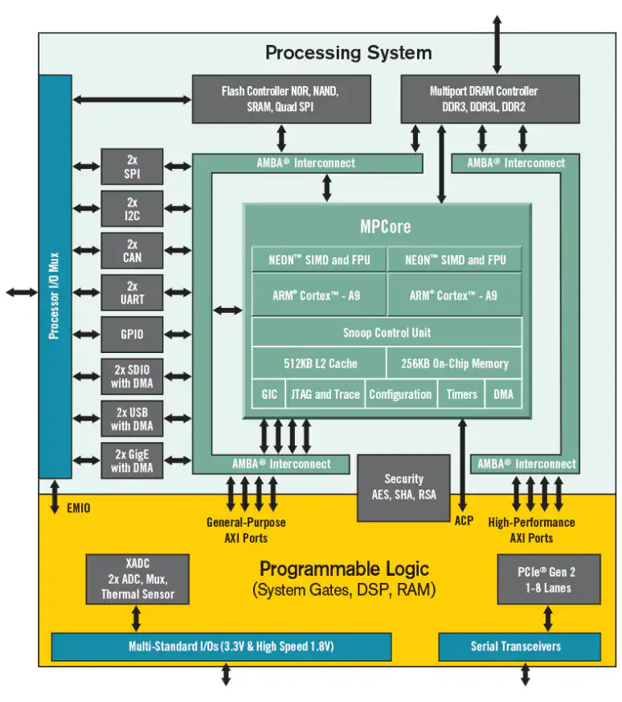
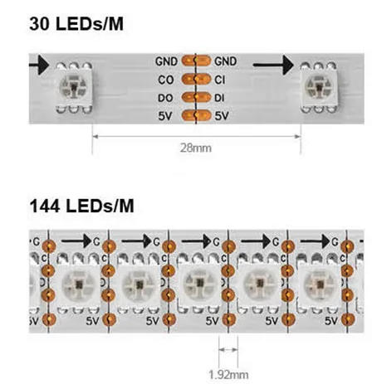
Introduction
LED chains:
Controlled by a serial protocol.
Can be controlled by software or hardware.
Intellectual property (IP) core design:
Zynq7000 is the selected hardware platform.
Two approaches were studied: hardware description language (HDL) and high-level synthesis (HLS).
Fig. 1. LED chains and Zynq7000.
Notes:
1

Slide 3
Task Description
SK9822-compatible controller must be developed and documented.
SW developers use memory-mapped interface to exchange data with CPU.
HW developers integrate controller into the system.
The final IP core will consist of the most effective approaches identified during the study.
Software Developer | Hardware Developer
Full color switching | Adjust LED number
Binary color switching | Limit brightness
Global brightness control | Set default brightness
Individual brightness control
Select transmission flow
Start transmission
Table. 1. Use cases.
Notes:
3

Slide 4
Research Methodology
Research Directions
Design approaches
HDL (Verilog / System Verilog)
HLS (C / C++)
Performance evaluation
Controller framerate
System framerate
Measure resources footprint
Look-Up Tables
Flip-Flops
Estimate scalability
Vertical
Horizontal
Notes:
4

Slide 5
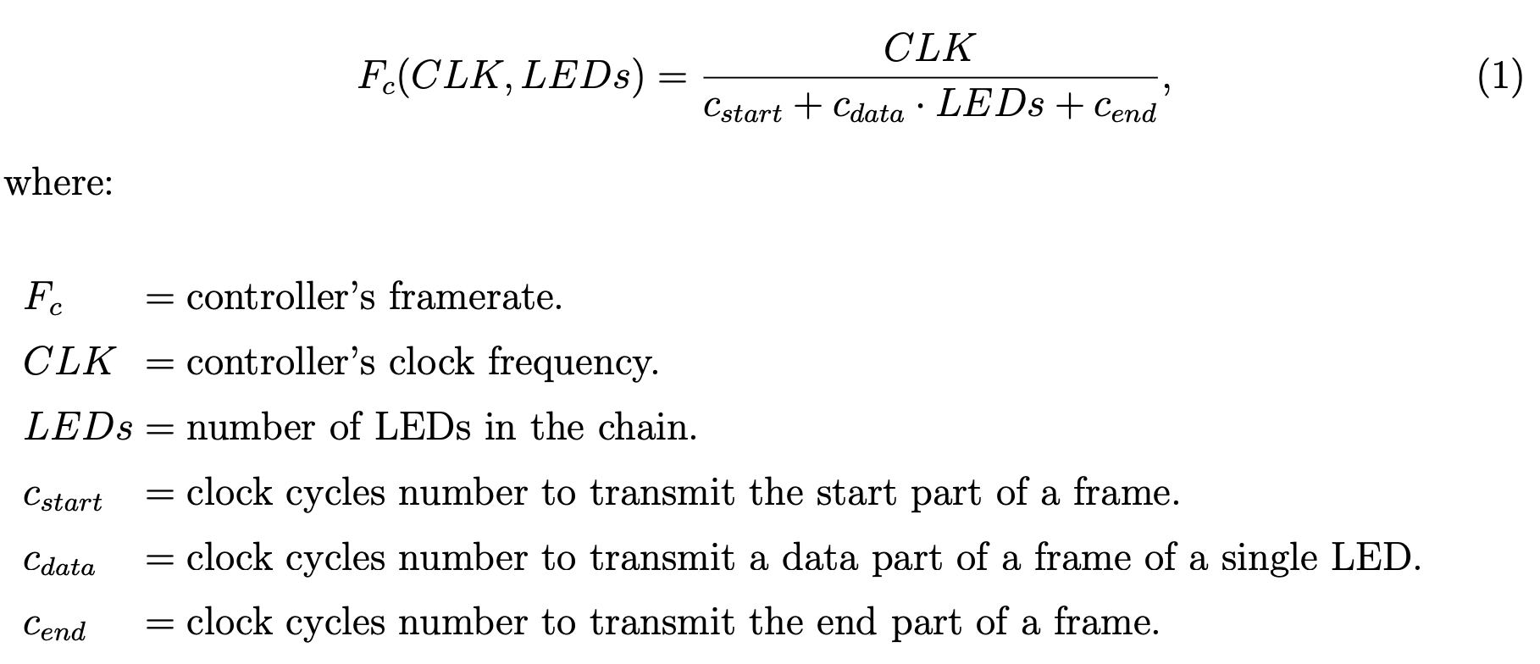
Research Methodology
Controller Framerate Formula
Notes:
5

Slide 6
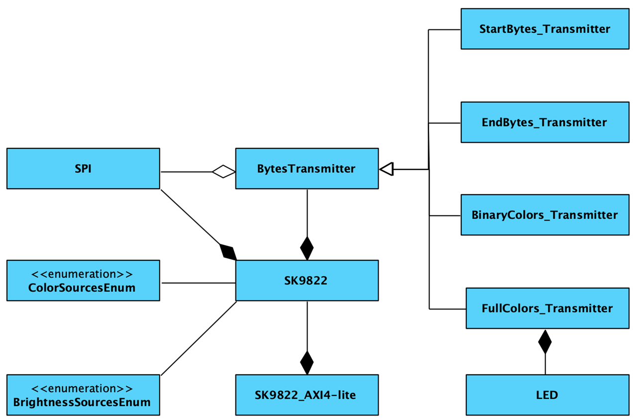
Controller Design
Internal Organization
SK9822 controller is wrapped in AXI interface.
SPI and Bytes Transmitter instances are optimized.
Inheritance should be replaced by multiplexing.
LED should be replaced by signals.
Fig. 2. Object-oriented model of the controller.
Notes:
7

Slide 7
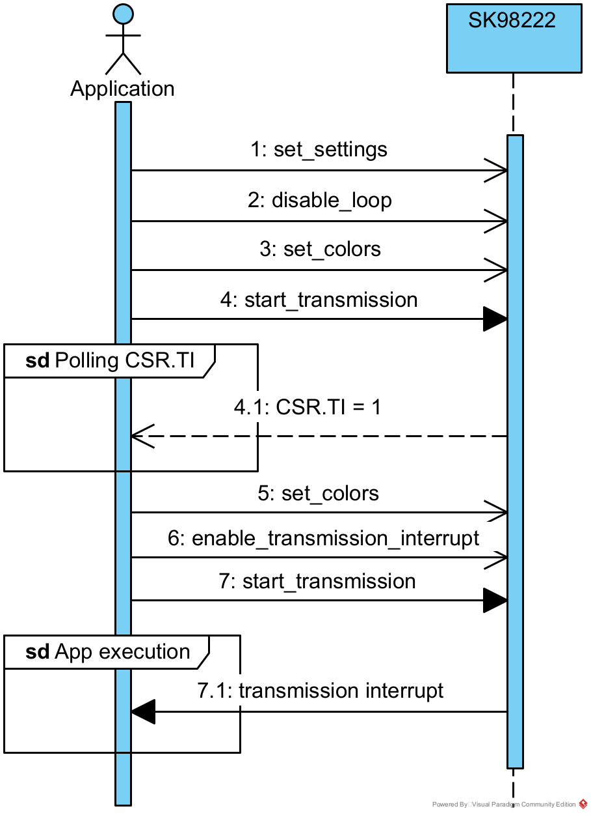
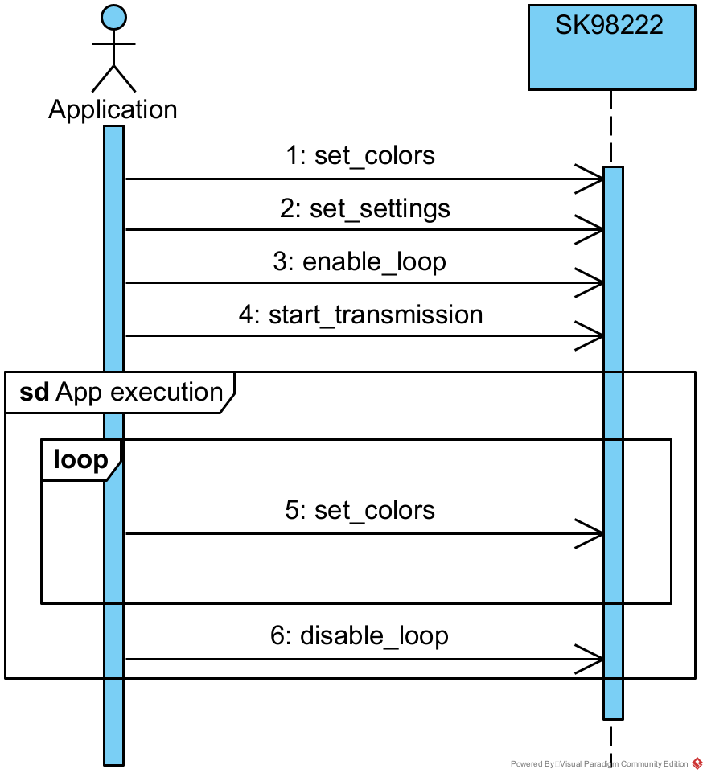
Controller Design
Runtime Scenarios
Fig. 3. Cyclic scenario.
Fig. 4. Acyclic scenario.
Notes:
9

Slide 8
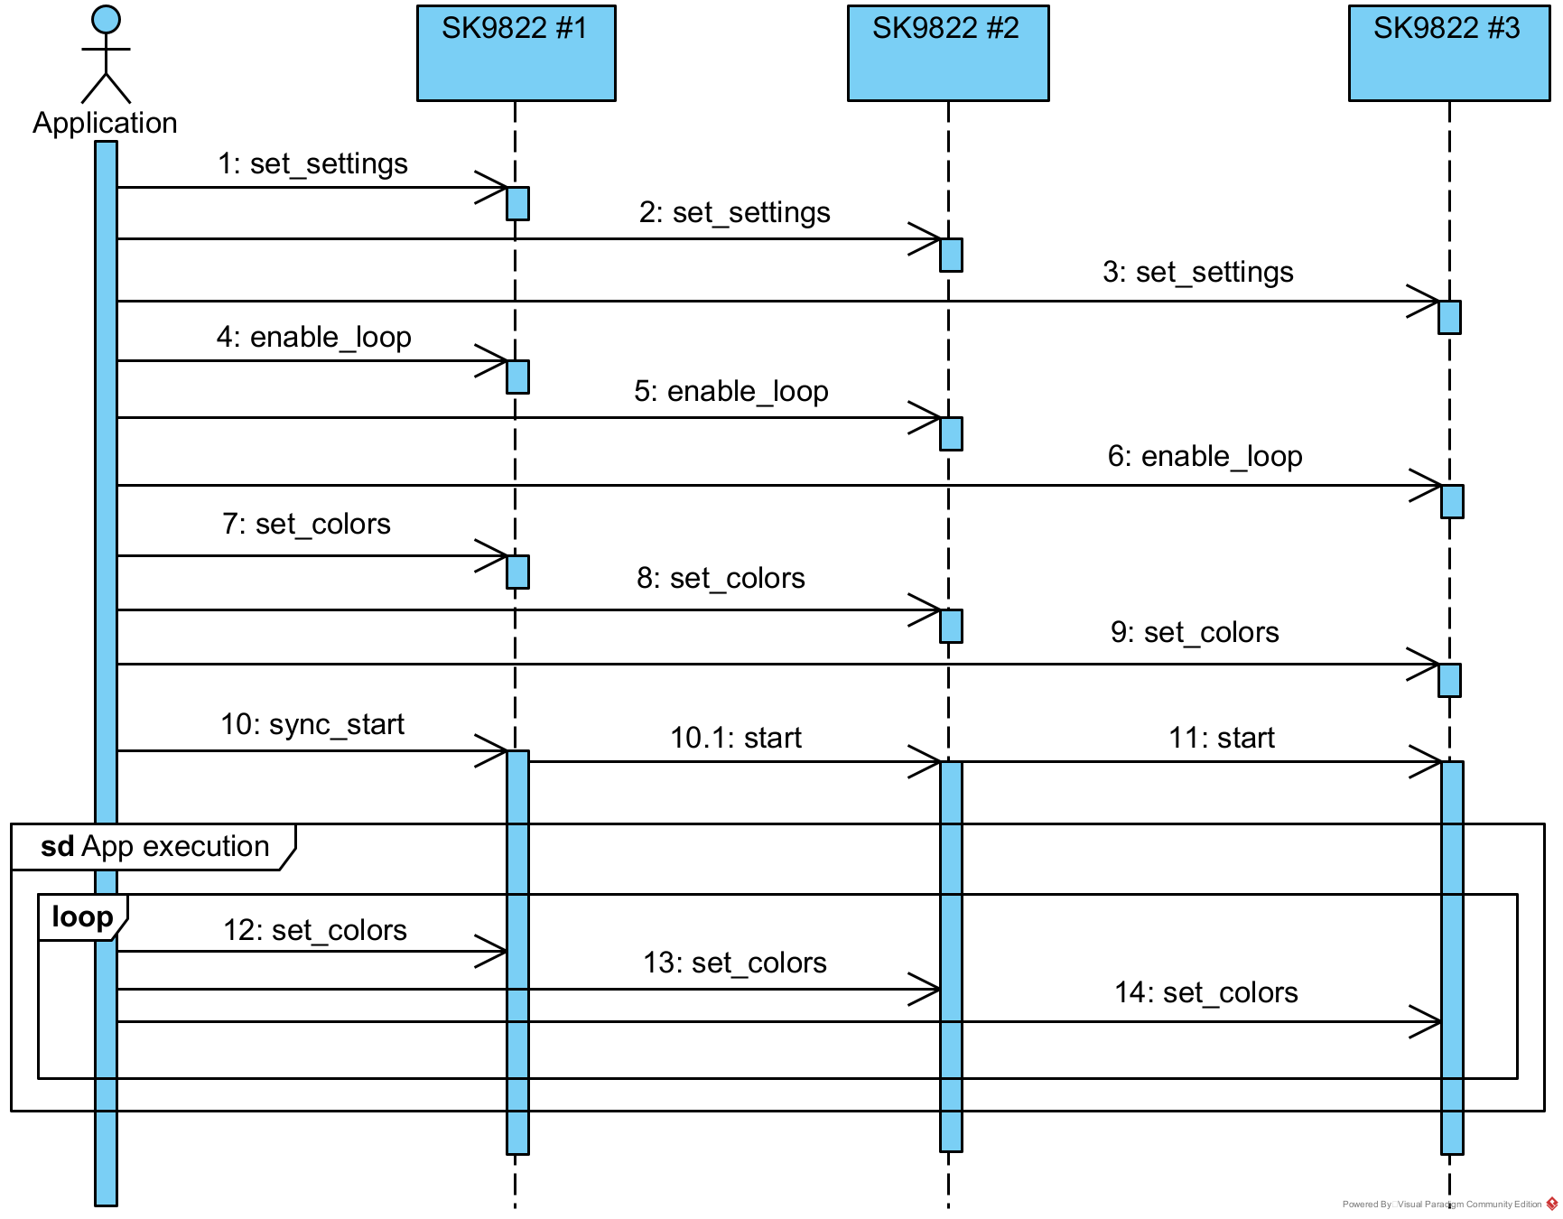
Controller Design
Synchronous Start
Synchronous start is a feature.
SCLK is shared.
I/O are optimized.
Main controller must be selected.
Fig. 5. Cyclic scenario + synchronous start.
Notes:
11

Slide 9
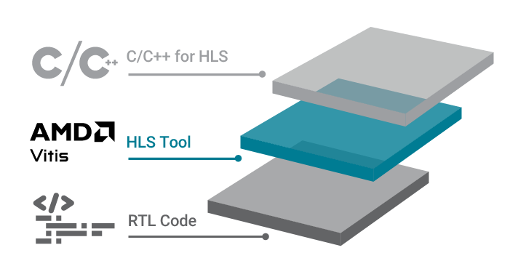
Study on high level synthesis (HLS)
Introduction
C/C++ functions are translated into RTL.
Provides a higher level of abstraction.
Applicability is a question.
Results comparison is the motivation.
Fig. 6. AMD Vitis HLS overview.
Notes:
13

Slide 10
Study on high level synthesis (HLS)
Findings
Architecture features:
Proposed techniques:
Concurrent C / C++ code.
State machines designed automatically.
SPI implementation is a challenge.
Tight timing increases development cost.
“#pragma HLS inline off”.
“#pragma HLS protocol” blocks.
Call “ap_wait()” delay function.
volatile output pointers in the top.
Notes:
15

Slide 11
Signal Diagrams
CLK
SCLK
MOSI
Fig. 7. HDL IP signal diagram.
CLK
SCLK
MOSI
Fig. 8. HLS IP signal diagram.
Notes:
16

Slide 12
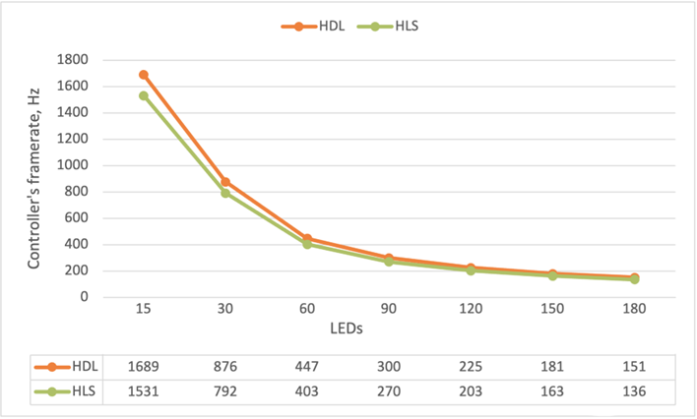
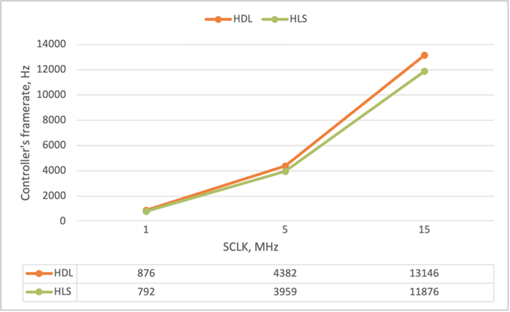
Results
Comparison of FPGA controllers' performance
Fig. 9. Fc(1MHz, LEDs)
Fig. 10 Fc(SCLK, 30)
Notes:
17

Slide 13
Results
Comparison of FPGA Resources Footprints
 | HDL | HLS | AXI4-lite (30LEDs) | Occupied by other blocks | Available in Zynq7020
Lookup tables | 375 | 921 | 559 | 691 | 53200
Flip-flops | 38 | 148 | 1350 | 737 | 106400
Table 2. FPGA resources utilization.
Notes:
19
HDL – 56 instances
HLS – 35 instances

Slide 14
Summary and Outlook
Requested SK9822-compatible IP cores were developed.
A study was conducted on HDL and HLS approaches.
Resulting IP may be used for scalability-sensitive applications.
HLS has room for improvement.
Notes:
20

Slide 15
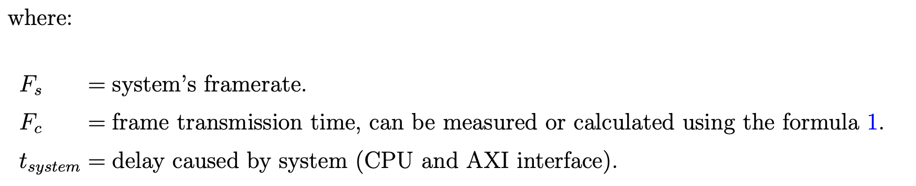
Appendix
System Framerate Formula

Slide 16
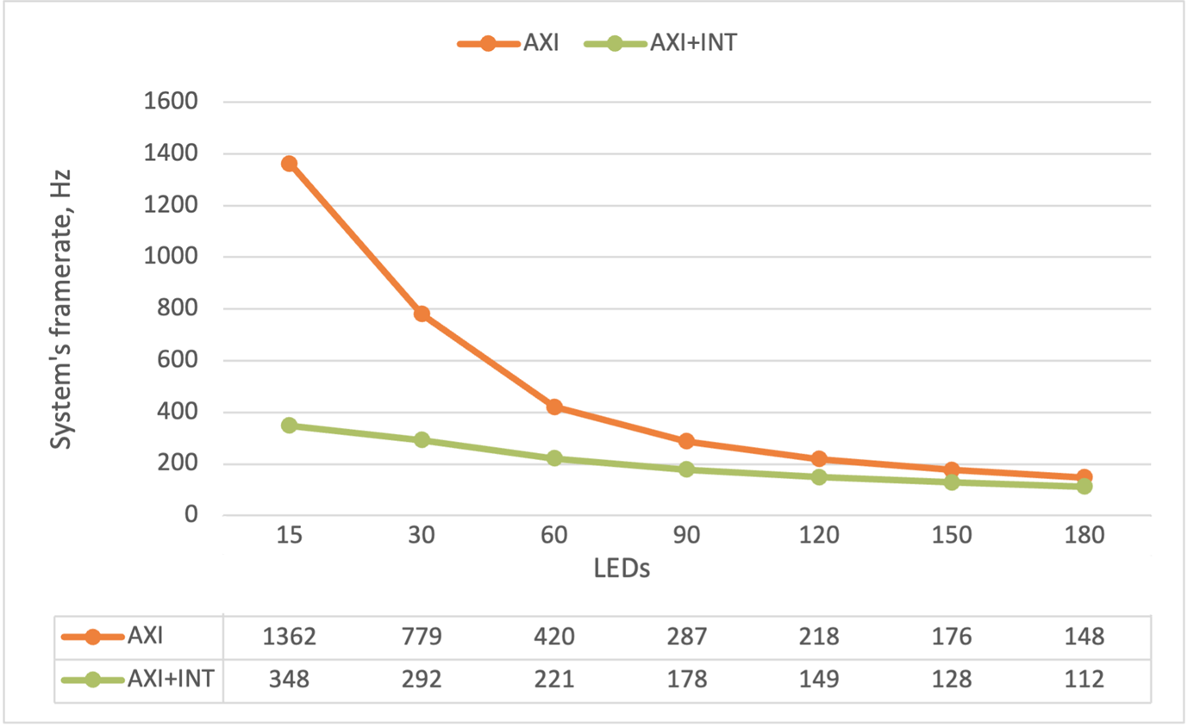
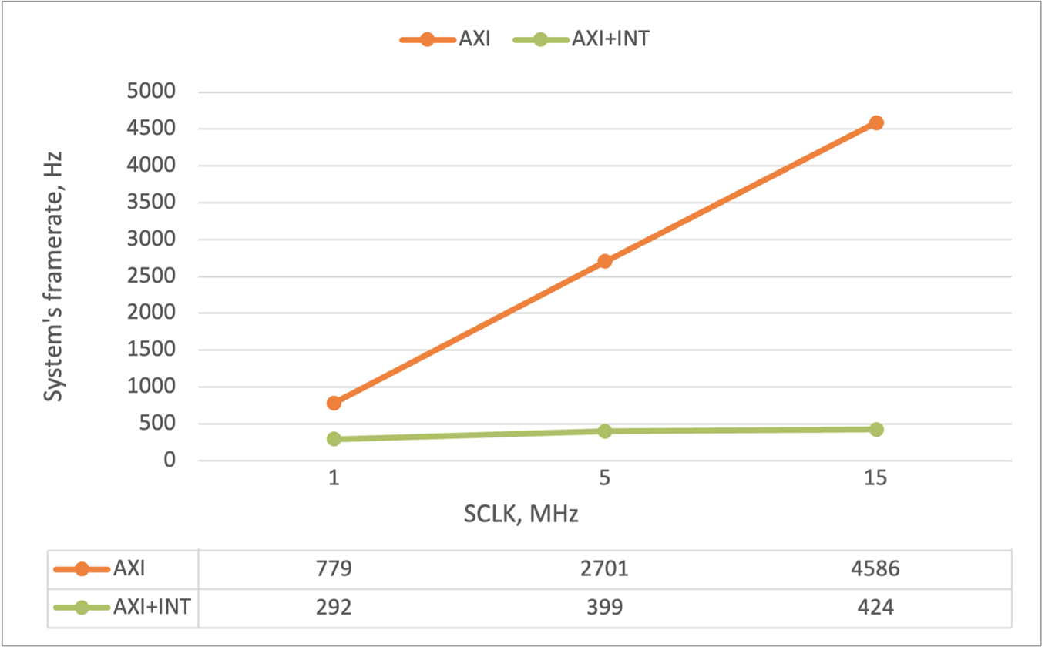
Appendix
Comparison of FPGA systems' performance
Fig. 11. FPGA Fs(1MHz, LEDs)
Fig. 12. FPGA Fs(CLK, 30)

Slide 17
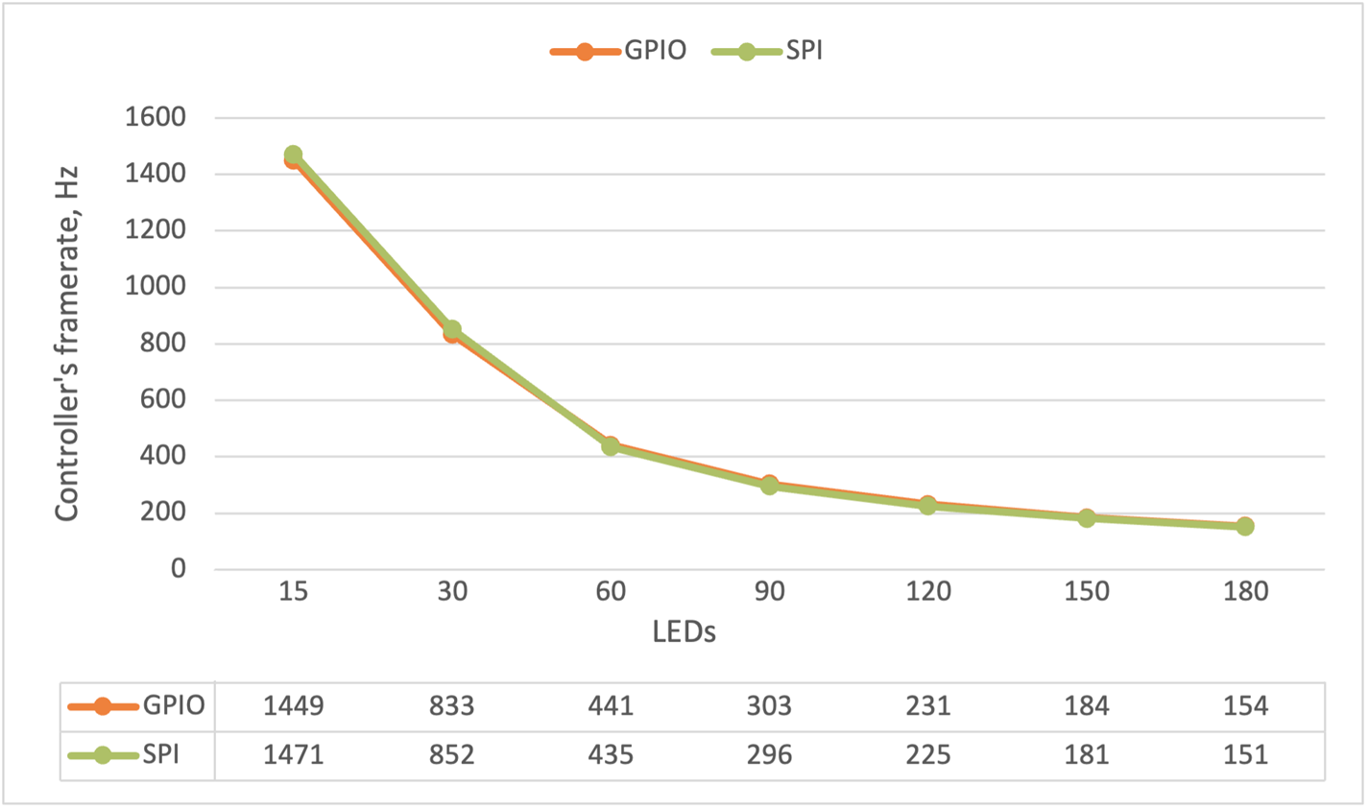
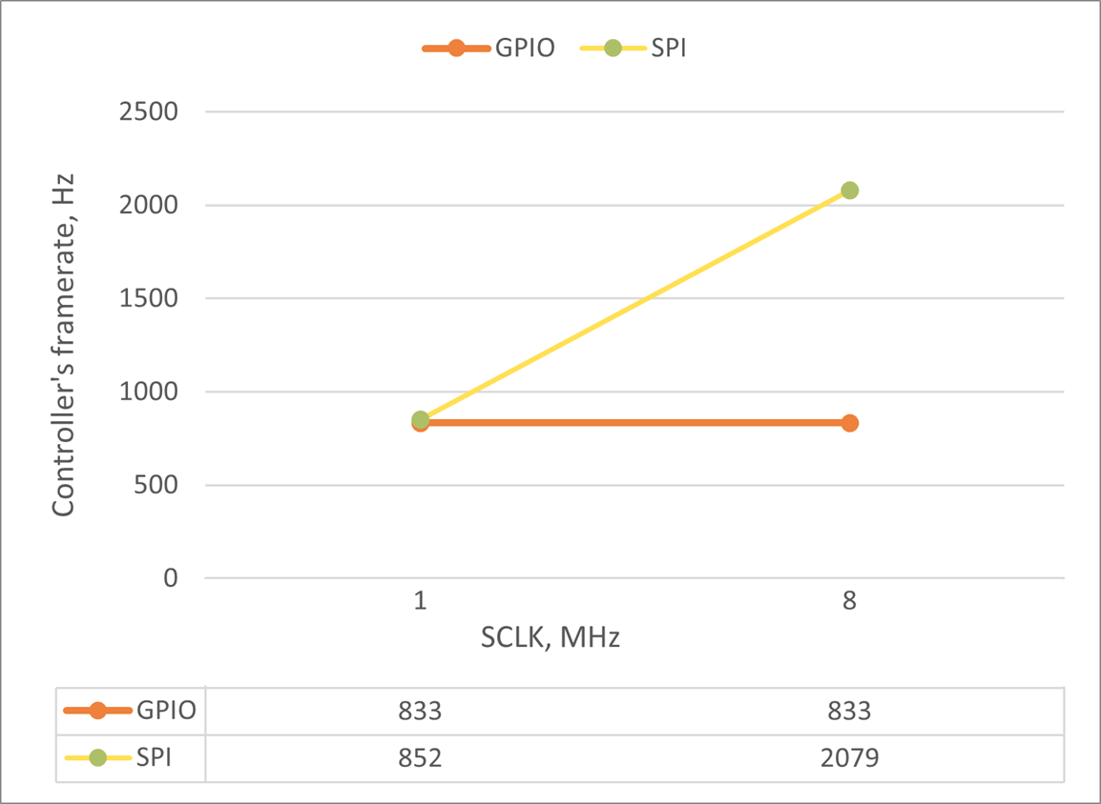
Appendix
Arduino UNO performance
Fig. 13. MCU Fs(1MHz, LEDs)
Fig. 14. MCU Fs(CLK, 30)

